Slide 1
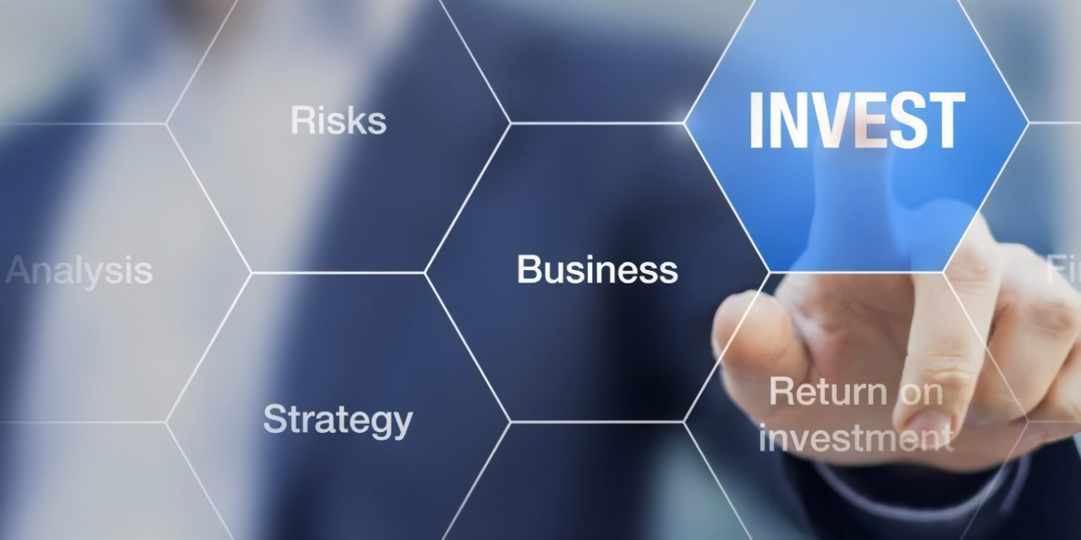
Introduction of my business in front of investors.
Tiffin Service is a meal delivery service that arrives at your door.
Starting investment of $20,000
Spend money on design and creating the website, initial marketing and leaflets.
Focusing on B2C marketing.
After growing the business, we will focus on B2C as well.
To expand our business, we will turn it in catering business.

Slide 2
Building trust with investors:
Be real and true with commitments
Introduction of products and services in brief.
Our business continuously going in profit.
Open feedbacks by customers regarding food and services.
Profitability of business from last years.

Slide 3
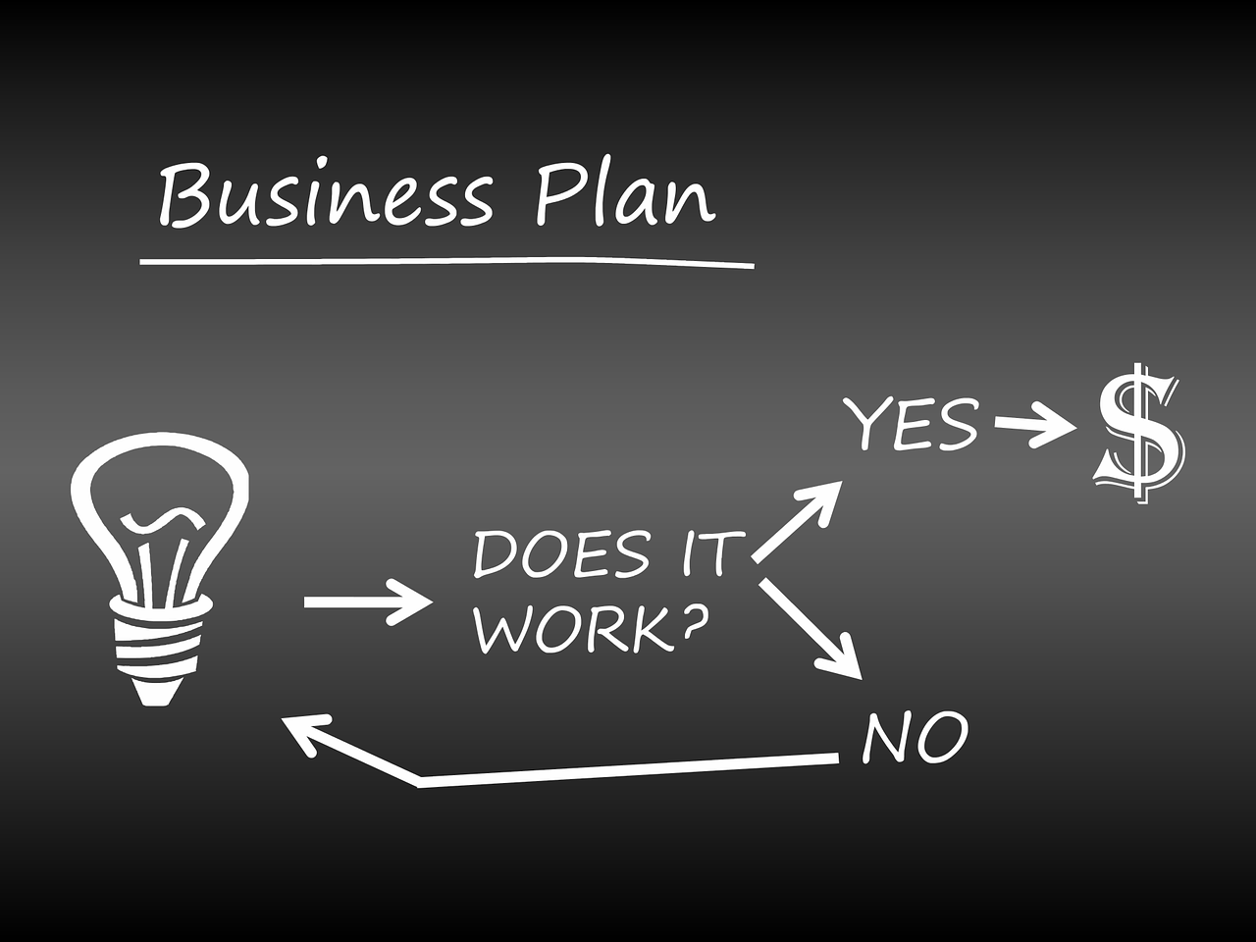
Reasons behind this business Idea:
Saw this business idea an opportunity to shine.
Experience in food industry.
I want to grow my cooking passion into my profession.
Felt the need of home-made food.

Slide 4
Why it will be successful:
Strong marketing Strategies.
Involvement of experts.
Expending it in different places.
By building the trust with customers and investors.
Continuously maintain the same quality and customers' trust as we are gaining from starting.
Bringing improvements to our products and services according to the customer's feedback.

Slide 5
Why I decided to run this business:
Because of my experience in food industry.
To fulfill the needs of those people who cannot make food at home.
Seek to improve the health and well-being of the community.
See the various opportunities in future to achieve the success.

