Slide 1
Introduction:

Slide 2
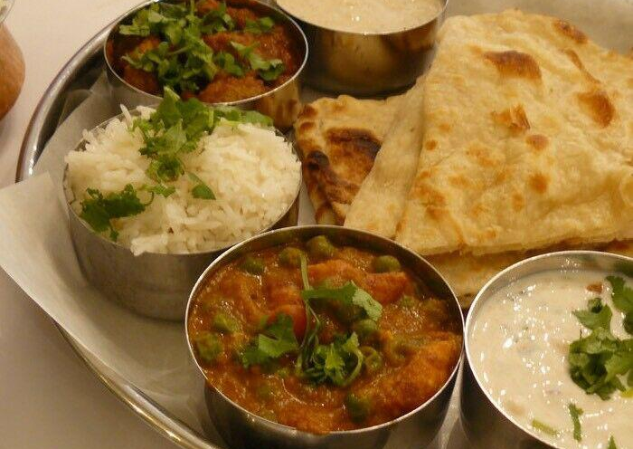
Tiffin Service- Taste like your home food:
Food business which provide meals to the people according their choices.
Targeting those who don’t have time to cook food.
It’s a meal delivery service that arrives at your door.
It includes two vegetables, breads(chapati), curd, and salad.
It provide meals to the people according their taste, choice and culture.

Slide 3
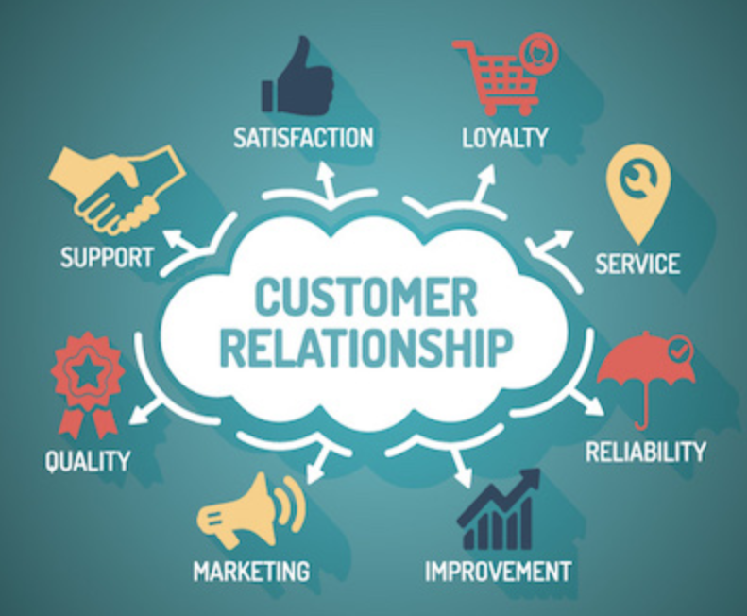
Creating trust for customers:
Best quality of the food.
Providing best customer services 24 hours.
Adhering to the Food Quality Standards
Guaranteed time for delivery at their doorsteps.
follow-ups with every customer in 15 days.

Slide 4
Identifying the problems :
Expensive and delayed product and services deliveries.
Health Issues because of unhealthy food.
People looking for a that kind of meal which have taste like their home-made food.
People concerns about high prices and low qualities.

Slide 5
Solutions for the problems:
Providing free and faster deliveries.
Providing best food qualities in less prices.
Open feedbacks
Providing pickup and delivery services according to their schedules.
Experts check on food safety every day.

